Slide 1

Customer Shopping Behavior Analysis

Slide 2

Project Overview
Analyzing 3,900 purchases to uncover key insights.
Spending Patterns
Customer Segments
Understand how customers spend.
Identify different buyer groups.
Product Preferences
Subscription Behavior
Discover what customers like.
Analyze recurring purchases.

Slide 3

Dataset Summary
Transactional data from 3,900 purchases.
Rows: 3,900
Columns: 18
Missing Data: 37 values in Review Rating
Key Features:
Customer demographics (Age, Gender, Location, Subscription)
Purchase details (Item, Category, Amount, Season, Size, Color)
Shopping behavior (Discount, Promo, Previous Purchases, Frequency, Review, Shipping)

Slide 4
Exploratory Data Analysis (Python)
Data preparation and cleaning for robust analysis.
01
02
03
Data Loading & Exploration
Missing Data Handling
Column Standardization
Imported with pandas, checked structure and statistics.
Imputed 'Review Rating' using median per category.
Renamed to snake_case for readability.
04
05
Feature Engineering
Database Integration
Created age_group and purchase_frequency_days.
Loaded cleaned data into PostgreSQL.

Slide 5
SQL Data Analysis: Key Business Questions
Structured analysis in PostgreSQL for actionable insights.
1
2
Revenue by Gender
High-Spending Discount Users
Male vs. Female customer revenue.
Customers using discounts but spending above average.
3
4
Top 5 Products by Rating
Shipping Type Comparison
Highest average review ratings.
Standard vs. Express average purchase amounts.

Slide 6

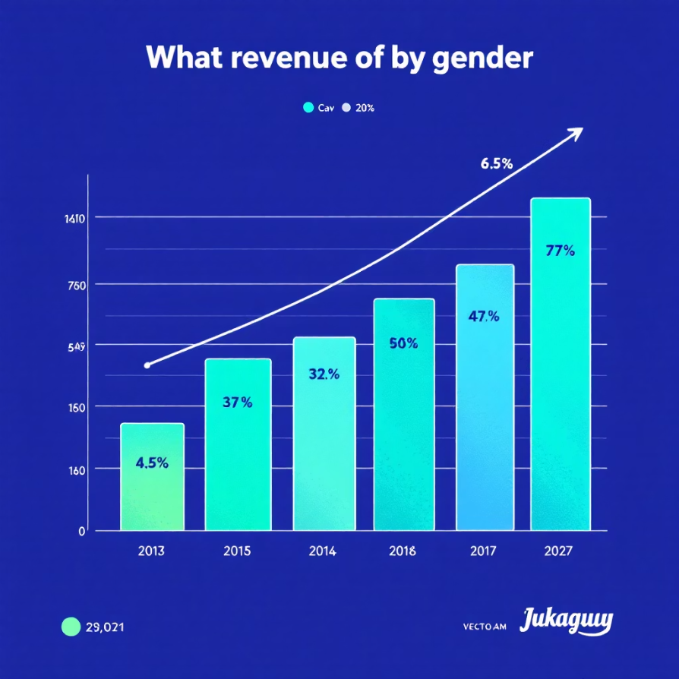
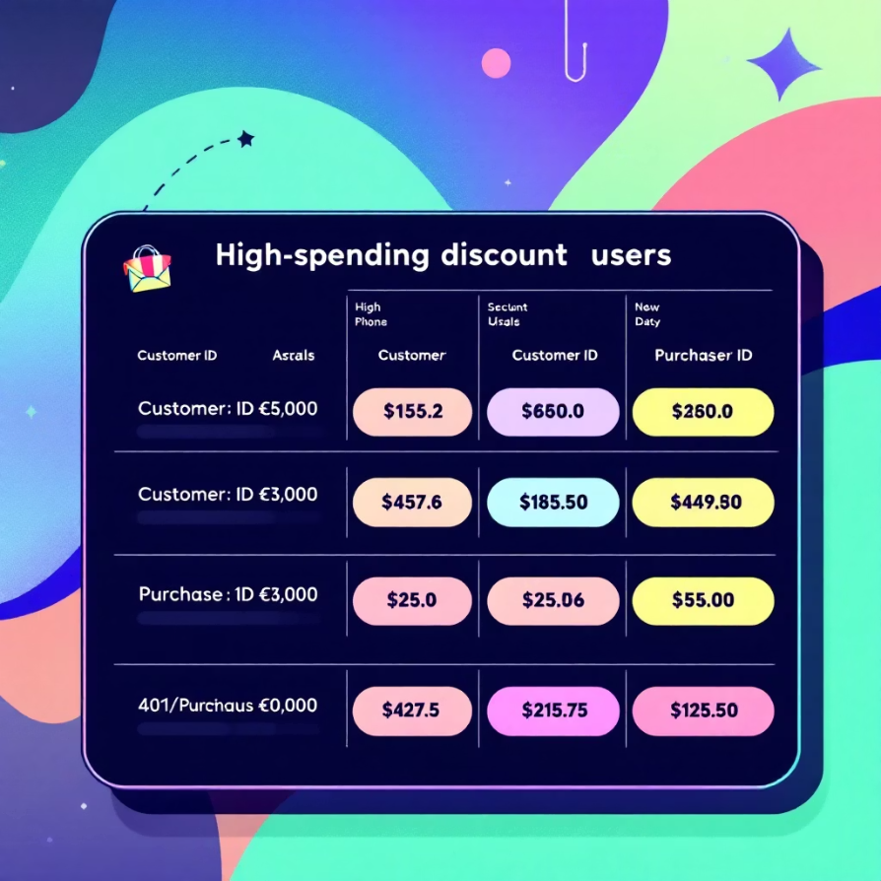
SQL Data Analysis: Deeper Dive
Gender revenue comparison.
Identifying valuable discount users.

Slide 7

SQL Data Analysis: Product & Loyalty
Subscribers vs. Non-Subscribers
Discount-Dependent Products
Average spend and total revenue comparison.
Top 5 products with highest discounted purchases.
Customer Segmentation
New, Returning, Loyal segments based on history.

Slide 8

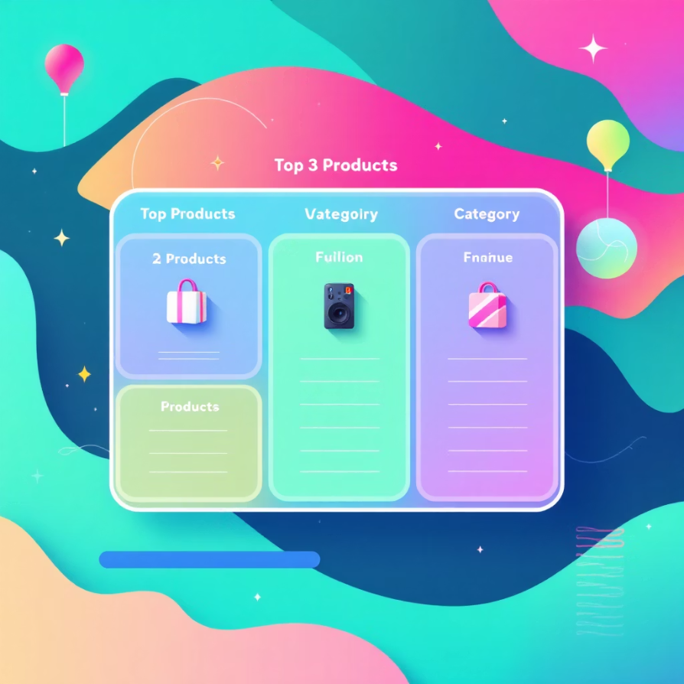
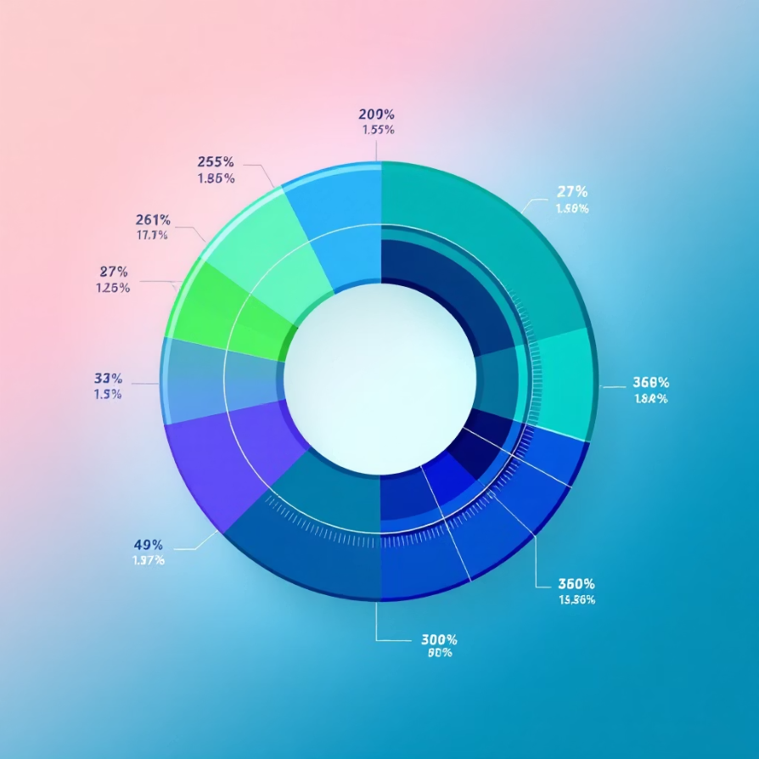
SQL Data Analysis: Top Products & Age
Most purchased items within each category.
Revenue contribution from each age group.

Slide 9

Interactive Dashboard in Power BI
Visualizing insights for strategic decision-making.
Dynamic Visuals
Key Metrics
Interactive charts and graphs.
At-a-glance performance indicators.
User-Friendly
Easy navigation for deep dives.

Slide 10





Business Recommendations
Actionable strategies for growth and efficiency.
Boost Subscriptions
Promote exclusive benefits.
Customer Loyalty
Reward repeat buyers.
Review Discount Policy
Balance sales with margins.
Targeted Marketing
Focus on high-revenue groups.

